Slide 1
Winter Term 20/21 Lecture-2 Comparing Graphs Graph Neural Networks
Prof. Dr. Holger Giese (holger.giese@hpi.uni-potsdam.de)
Christian Medeiros Adriano (christian.adriano@hpi.de) - “Chris”
Sona Ghahremani (sona.Ghahremani@hpi.de )

Slide 2
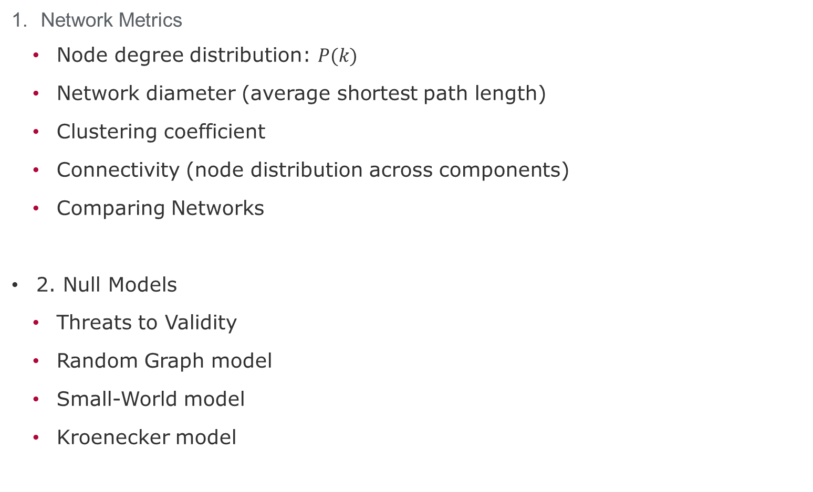
Lecture topics
Network Metrics
Node degree distribution: $P(k)$
Network diameter (average shortest path length)
Clustering coefficient
Connectivity (node distribution across components)
Comparing Networks
2. Null Models
Threats to Validity
Random Graph model
Small-World model
Kroenecker model

Slide 3
Node Degree Distribution $P\left(k\right)=N_{k}/N$
A
2
B
4
C
D
3
2
 | A | C | D | B | E | F | ∑
A | 1 | 1 | 1 | 1 | 0 | 0 | 4
C | 1 | 0 | 1 | 1 | 0 | 0 | 3
D | 1 | 1 | 0 | 1 | 0 | 0 | 3
B | 1 | 1 | 1 | 0 | 1 | 1 | 5
E | 0 | 0 | 0 | 1 | 0 | 1 | 2
F | 0 | 0 | 0 | 1 | 1 | 0 | 2
E
A
F
B
C
D

Slide 4
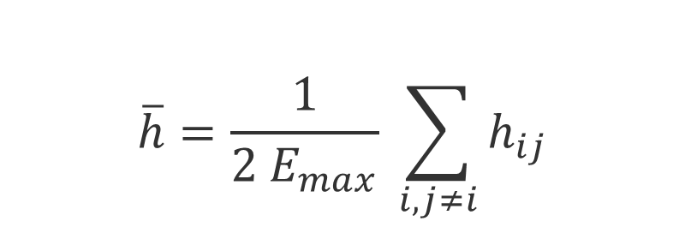
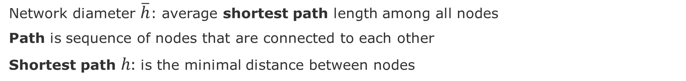
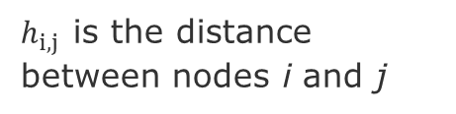
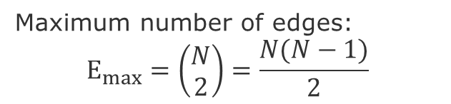
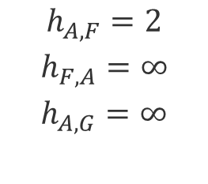
Network Diameter (or geodesic distance)
Network diameter $\overline{h}$: average shortest path length among all nodes
Path is sequence of nodes that are connected to each other
Shortest path $h:$ is the minimal distance between nodes
E
$$\overline{h}=\frac{1}{2 E_{max}} \sum_{i,j≠i}{h_{ij}}$$
A
F
B
H
C
G
D
Maximum number of edges:
$$E_{max}=\left(\begin{aligned}N \\ 2\end{aligned}\right)=\frac{N(N−1)}{2}$$
$$h_{A,F}=2$$
$$h_{F,A}=∞$$
$$h_{A,G}=∞$$
$h_{i,j }$is the distance between nodes i and j

Slide 5
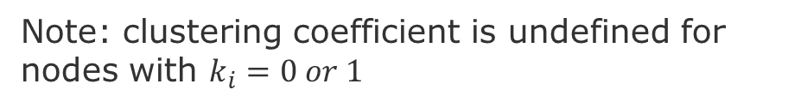
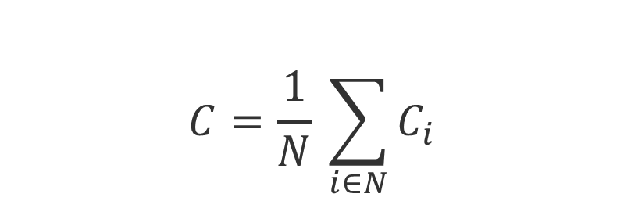

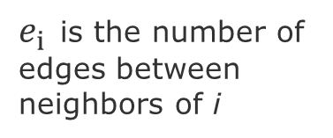
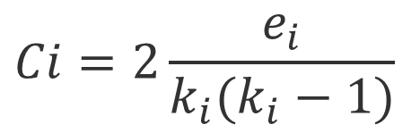
Clustering coefficient $C_{i}$
$C_{i}$Measures how many of my neighbors are connected to each other
$$C_{i}∈\left[0,1\right]$$
$$Ci=2\frac{e_{i}}{k_{i}(k_{i}−1)}$$
A
A
A
A
$e_{i }$is the number of edges between neighbors of i
B
B
B
B
C
C
C
C
D
D
D
D
$$C_{A}$$
0.0
0.3
=2*1/3*2
0.67
=2*2/3*2
1.0
=2*3/3*2
total possible edges
Note: clustering coefficient is undefined for nodes with $k_{i}=0 or 1$
Average Clustering Coefficient
$$C=\frac{1}{N} \sum_{i∈N}{C_{i}}$$
Notes:
Clustering coefficient is undefined for nodes with ki = 0 or 1

Slide 6
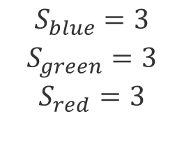
Connectivity $S$
Connectivity $S$: is the largest set of nodes that can be connected through any given path
E
A
F
B
H
C
G
D
$$S_{blue}=3$$
$$S_{green}=3$$
$$S_{red}=3$$

Slide 7
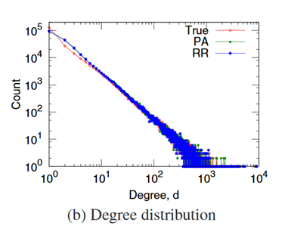
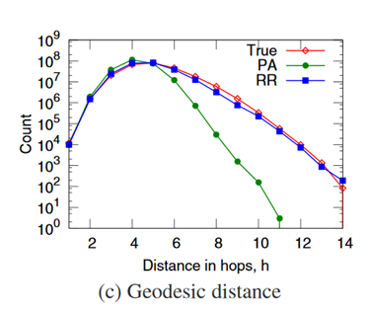
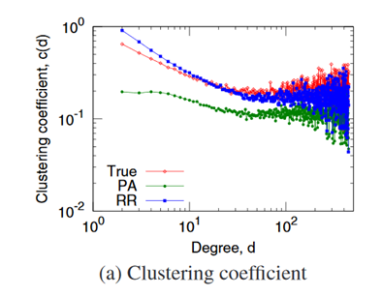

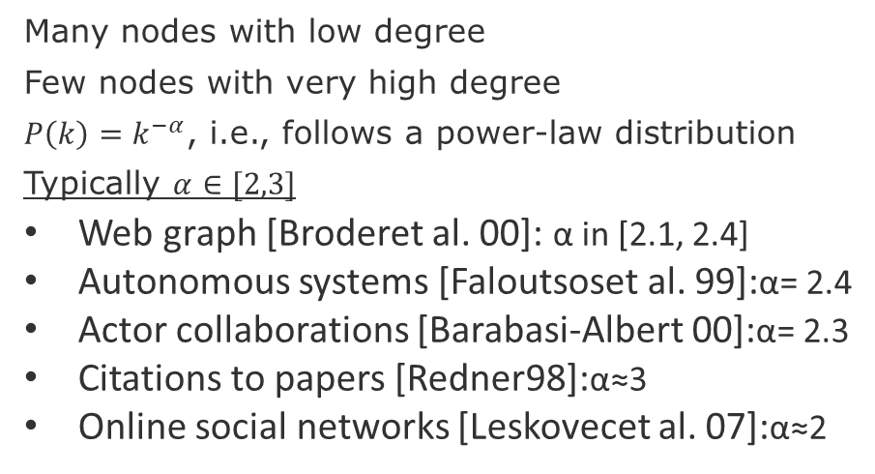
Empirical values (Flickr)
$$P\left(k\right)=k^{−α}$$
Many nodes with low degree
Few nodes with very high degree
$P\left(k\right)=k^{−α}$, i.e., follows a power-law distribution
Typically $α∈[2,3]$
Web graph [Broderet al. 00]: α in [2.1, 2.4]
Autonomous systems [Faloutsoset al. 99]:α= 2.4
Actor collaborations [Barabasi-Albert 00]:α= 2.3
Citations to papers [Redner98]:α≈3
Online social networks [Leskovecet al. 07]:α≈2
Few hops on average allow to reach anywhere in the network
Low degree nodes tend to have higher clustering
Note: remember to plot degree distributions and clustering coefficients in log-log scale
Source: Leskovec, Jure, et al. "Microscopic evolution of social networks." Proceedings of the 14th ACM SIGKDD 2008.

Slide 8
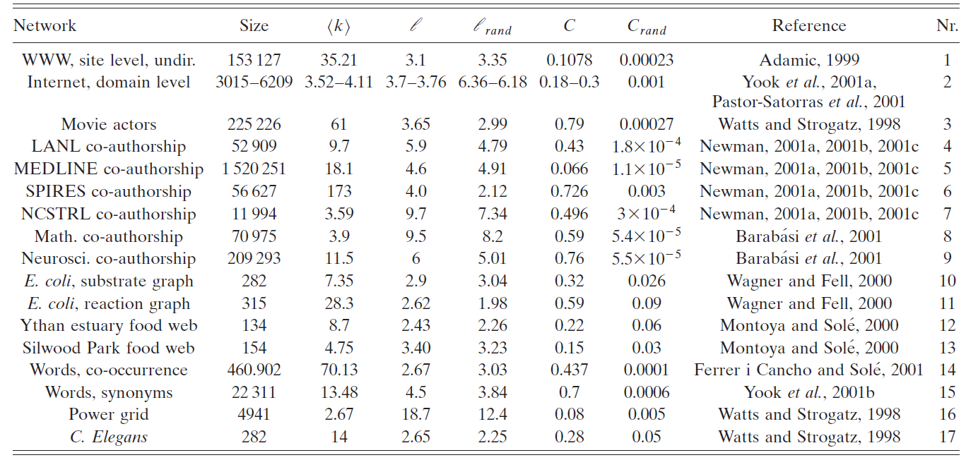
Comparing some networks
Average Clustering coefficient
Average degree
Network diameter
Source:
Albert, R., & Barabási, A. L. (2002). Statistical mechanics of complex networks. Reviews of modern physics, 74(1), 47.

Slide 9
Other ways of comparing networks
Known Node Correspondence Methods:
Difference of the adjacency matrices
DeltaCon (similarity between node pairs)
Cut distance
Unknown Node Correspondence Methods:
global statistics,
matching of subgraphs (graphlets)
Relative Graphlets Frequency Distance (RGFD)
Graphlet Degree Distribution Agreement (GDDA)
alignment-based methods entropy measures (isomorphism)
spectral methods (distance-based)
Source: Tantardini, M., Ieva, F., Tajoli, L., & Piccardi, C. (2019). Comparing methods for comparing networks. Scientific reports, 9(1), 1-19.

Slide 10
Null Models

Slide 11
Motivation
We need null-models to compare our graph metrics in a principle and reproducible manner
Obtain a real network
Generate a synthetic network
Compare networks
Null-models are generate by synthetic graph generation procedures.
Random Graph Model
Small-World Model
Kronecker Graph Model

Slide 12
Threats to validity
Construct validity: measurements might not be correct
Conclusion validity: instruments or methods adopted are not adequate
Internal validity: relations of cause-effect might not be true
External validity: results do not generalize to slight changes in the data or context.
Recommended readings:
Siegmund, J., Siegmund, N., & Apel, S. (2015, May). Views on internal and external validity in empirical software engineering. In Proceedings of the 37th International Conference on Software Engineering-Volume 1 (pp. 9-19). IEEE Press.
Wieringa, R. J. (2014). Design science methodology for information systems and software engineering. Springer.
Wohlin, C., Runeson, P., Höst, M., Ohlsson, M. C., Regnell, B., & Wesslén, A. (2012). Experimentation in software engineering. Springer Science & Business Media.

Slide 13
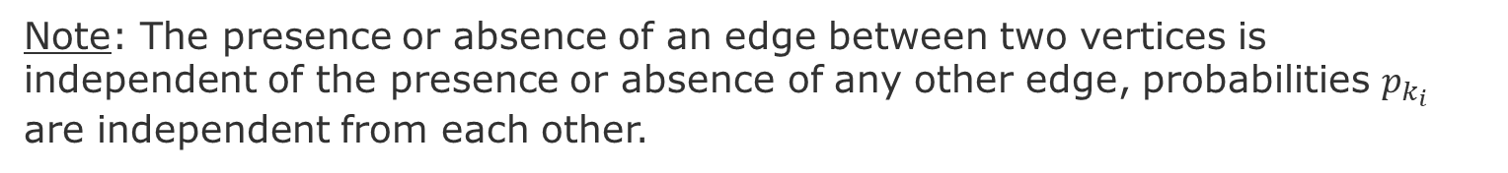
Random Graph - Erdös-Rényi (ER) networks
Stochastically connect nodes
E
E
E
A
A
A
F
F
F
B
H
B
H
B
H
C
G
C
G
C
D
D
G
D
Procedure:
For each pair of nodes decide do connect them with a probability $p_{k}$
Note: The presence or absence of an edge between two vertices is independent of the presence or absence of any other edge, probabilities $p_{k_{i}}$ are independent from each other.
Source: Newman, Mark EJ, Steven H. Strogatz, and Duncan J. Watts. "Random graphs with arbitrary degree distributions and their applications." Physical review E 64.2 (2001): 026118.

Slide 14
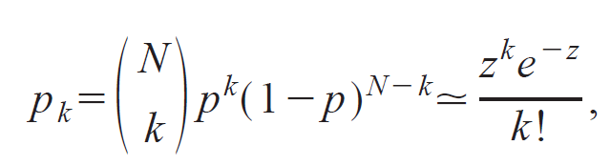
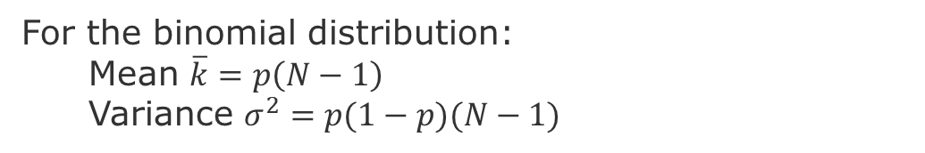
Random Graph – Distribution of Node Degree
Distribution of Node Degrees
z = average number of edges
k = degree of an edge
In the limit when N is very large. i.e., a Poisson distribution
For the binomial distribution:
Mean $\overline{k}=p\left(N−1\right)$
Variance $σ^{2}=p(1−p)(N−1)$
Newman, Mark EJ, Steven H. Strogatz, and Duncan J. Watts. "Random graphs with arbitrary degree distributions and their applications." Physical review E 64.2 (2001): 026118.
Notes:
Poisson Distribution = probability of a given number of events occurring in a fixed interval of time or space if these events occur with a known constant mean rate and independently of the time since the last event

Slide 15
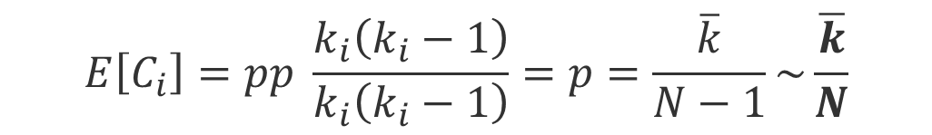
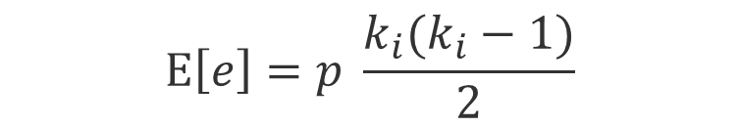
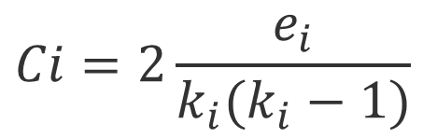
Random Graph – Clustering coefficient
Clustering coefficient:
$$Ci=2\frac{e_{i}}{k_{i}(k_{i}−1)}$$
$$E\left[e\right]=p \frac{k_{i}(k_{i}−1)}{2}$$
$$E\left[C_{i}\right]=pp \frac{k_{i}\left(k_{i}−1\right)}{k_{i}\left(k_{i}−1\right)}=p=\frac{\overline{k}}{N−1}\sim \frac{\overline{k}}{N}$$
This means that the clustering coefficient of a random graph is small. As we generate bigger random graphs with a fixed average degree k, i.e., we set 𝑝=𝑘⋅1/N), C will decrease with the graph size N
Notes:
To derive this formula see

Slide 16
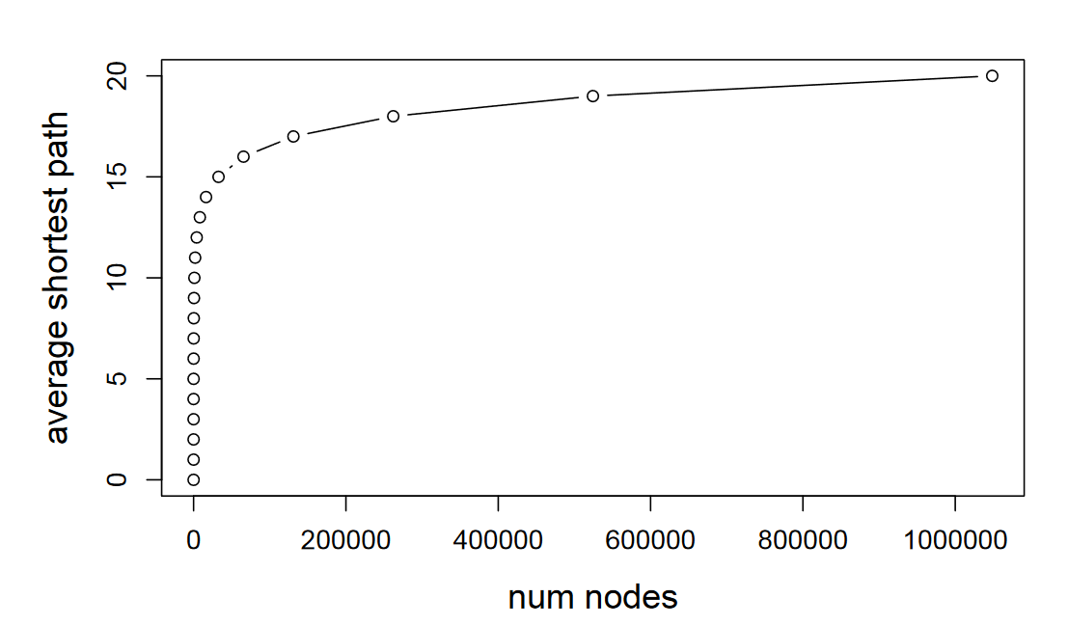
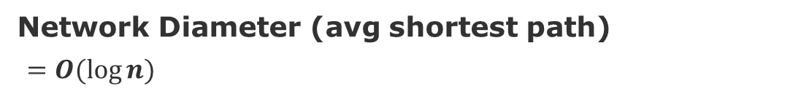
Random Graph – Network Diameter
Network Diameter (avg shortest path)
$=O(log⁡n)$
[Leskovec 2019]
Average degree constant
Notes:
[Leskovec 2019] http://web.stanford.edu/class/cs224w/slides/02-gnp-smallworld.pdf

Slide 17
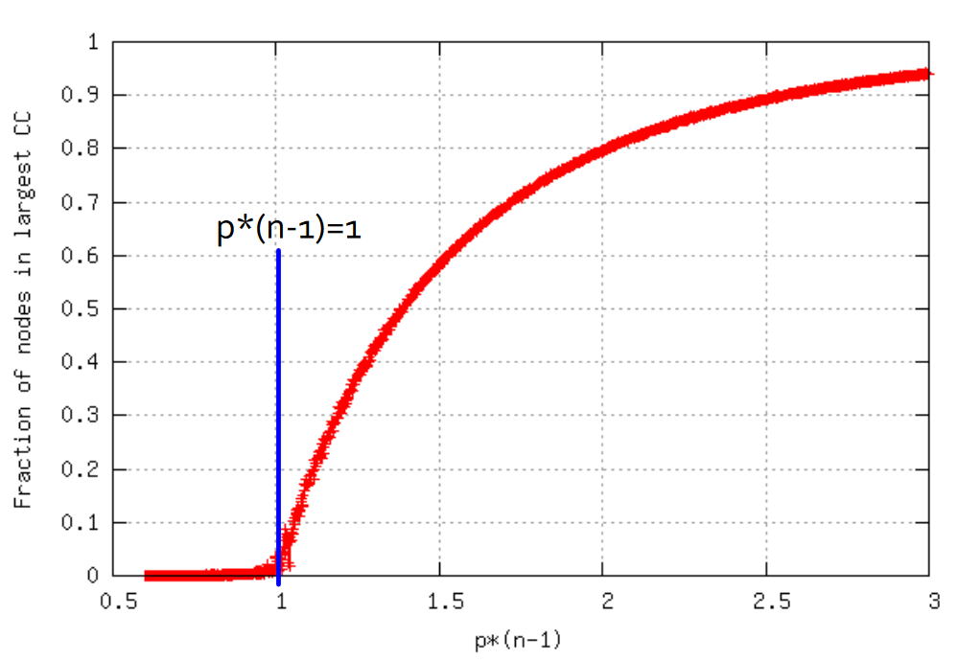
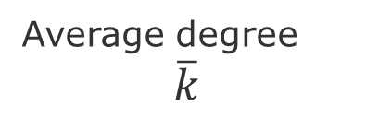
Random Graph – Connectivity
Tend to have giant components
Everything gets connected.
Disconnected graph
Fully connected graph
Average degree
$$\overline{k}$$

Slide 18
Again - Comparing some networks
Average Clustering coefficient
Average degree
Network diameter
Actors
Power grid
C. elegans
Source:
Albert, R., & Barabási, A. L. (2002). Statistical mechanics of complex networks. Reviews of modern physics, 74(1), 47.

Slide 19
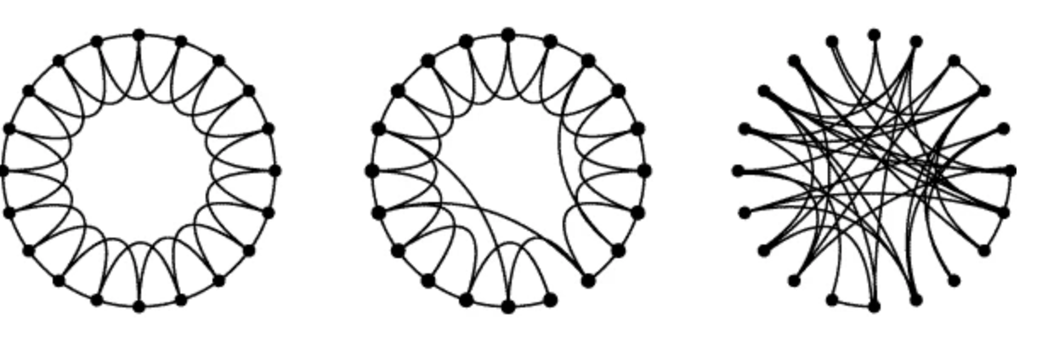
Small-World Model = high clustering + short paths
Regular
Small-World
Random
Note:
Clustering implies edge “locality”
Randomness enables “shortcuts
p =0
p=1
p = probability of reconnecting uniformly
Clustering
Diameter
High
High
High
Low
Low
Low
Procedure:
start with a ring of n vertices, each connected to its k-nearest neighbors by undirected edges.
choose a node and the edge that connects it to its nearest neighbor in a clockwise.
reconnect with probability p this edge to a node chosen uniformly over the entire ring
Source: Watts, Duncan J., and Steven H. Strogatz. "Collective dynamics of ‘small-world’networks." nature 393.6684 (1998): 440-442.
Notes:
Procedure: start with a ring of n vertices, each connected to its k nearest neighbors by undirected edges.
We choose a node and the edge that connects it to its nearest neighbor in a clockwise sense. With probability p, we reconnect this edge to a vertex chosen uniformly at random over the entire ring.

Slide 20
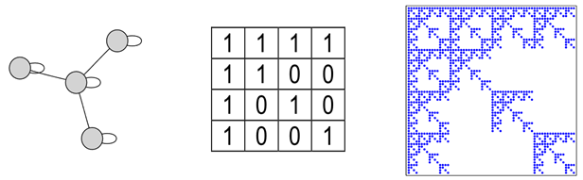
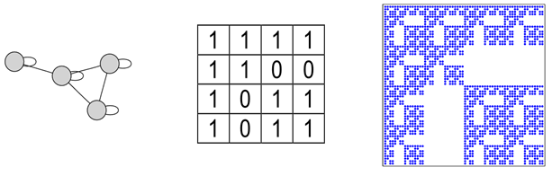
Kronecker Model
Small-World model captures the structure of many realistic networks
However, it does not produce the correct degree distribution
Solution: use the idea do self-similarity (the whole is in the parts)
Code do generate: https://github.com/BenjaminDHorne/Stochastic-Kronecker-Generator
Source: Leskovec, Jure, et al. "Kronecker graphs: an approach to modeling networks." Journal of Machine Learning Research 11.2 (2010).

Slide 21
Next steps
Send groups names and members to Chris (by Friday)
Remember to:
Accept Slack invitation
Study datasets
See examples of use of Snap or NetworkX
Think of scenarios

Slide 22
END

